Slide 1
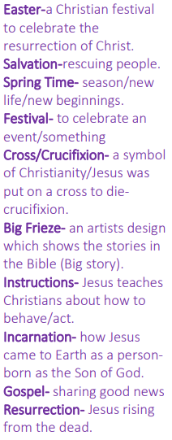
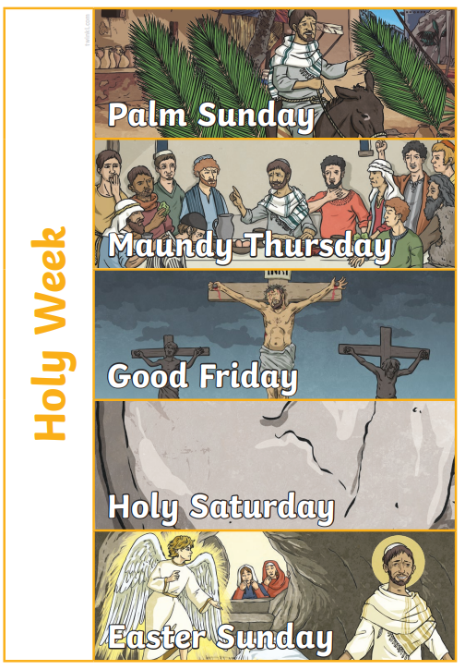
St. Mary’s Church of England Primary School and Nursery​
Be the BEST you can be​
Year 1 | RE | Salvation: Why is Easter important to Christians?
Easter Eggs are used by Christians not just as yummy treats but as reminders - of the New Life offered in Jesus, - of the stone in front of the tomb on Good Friday - of the hollow empty tomb on Easter Day (when broken open
Easter Eggs are used by Christians not just as yummy treats but as reminders
of the New Life offered in Jesus,
of the stone in front of the tomb on Good Friday
of the hollow empty tomb on Easter Day (when broken open)
Christians believe that Jesus is the Son of God, he came to Earth and lived for 33 years. He was killed on a cross but came back to life 3 days later. Christians believe that Jesus came to restore the friendship between humans and God that was broken by Adam and Eve, and that this would be mended once and for all.

