Slide 1

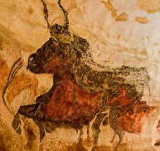
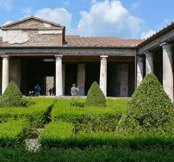
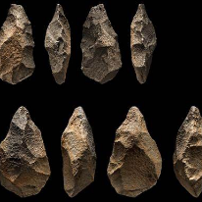
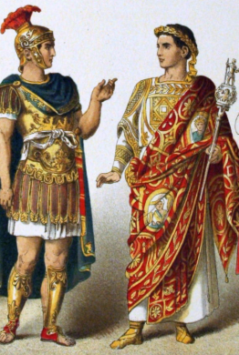
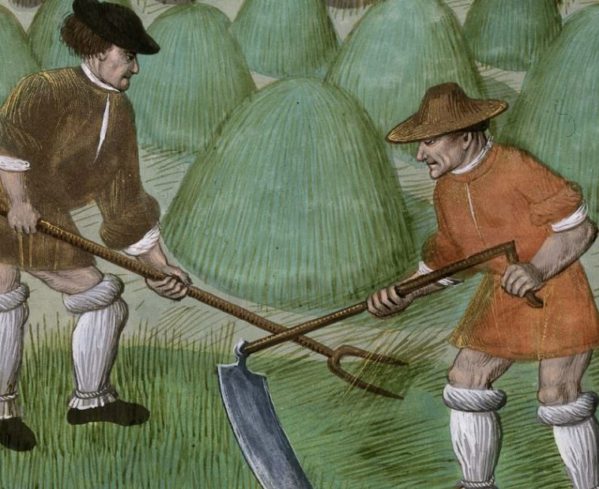
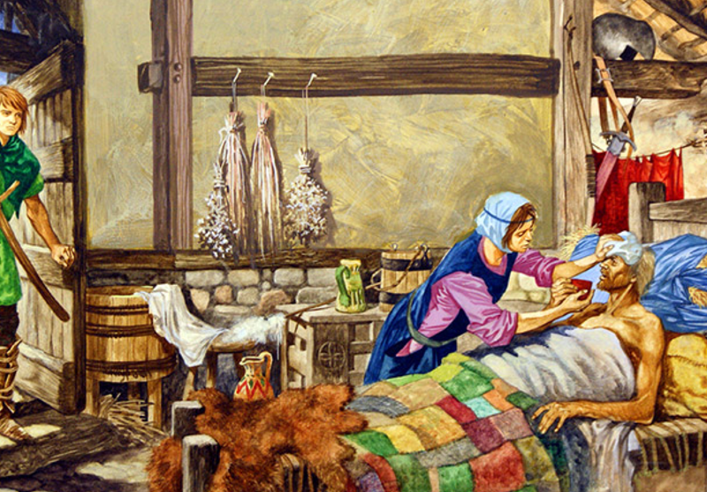
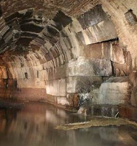
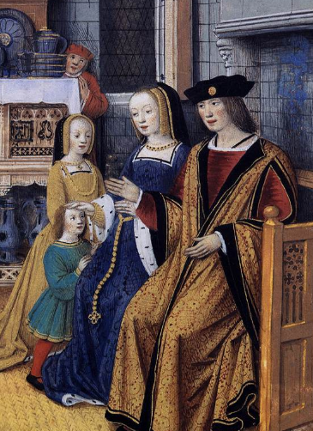
St. Mary’s Church of England Primary School and Nursery
Be the BEST you can be
A Street Through Time
 | Key Vocabulary
Stone Age | A time when people used stone tools and lived in caves or simple shelters.
Iron Age | A time when people made tools and weapons from iron and built stronger homes and forts.
Hunter gatherer | A person who finds food by hunting and gathering instead of farming.
Nomad | A person who doesn’t live in one spot for long.
Catapult | A big machine that throws rocks or other objects to break things far away.
Farmers | A person who grows food and looks after animals.
Romans | People from ancient Rome who built a powerful empire long ago.
Castle | A big, strong building where people lived and stayed safe
Black Death | A sickness long ago that made many people very ill and die.
Stone Age Compared to Today
In the Stone Age, people lived in caves or simple huts, but today, we have houses made of bricks with electricity and running water.
Stone Age people hunted animals and gathered plants for food, while today we can buy our food from supermarkets.
Tools in the Stone Age were made from stone and wood, but now we use machines and technology to make things faster and easier.
Romans
The Romans built strong houses using bricks and stones, which helped people stay safe and warm, and this idea is still used in building houses today.
They also created drains and pipes to carry dirty water away, which is how we now have modern toilets and plumbing in our homes.
Working life
Rich people:
managed land
ran businesses
worked for the king,
Poor people worked as:
farmers,
Servants
blacksmiths
weavers to earn a living.
Did you know?
.
The Black Death made many people very sick and die, so farmers and others had fewer workers to help, which made life and work much harder for everyone.

