Slide 1
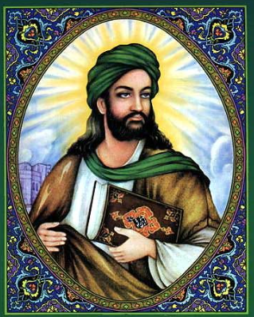
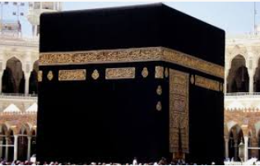
How important is the prophet Muhammed to Muslims?
St Mary’s C of E
Primary School and Nursery
‘Be the BEST you can be’
Key Vocabulary
Allah | Muslim name for God
Muhammad | Messenger chosen by Allah
Makkah | City where Islam began
Saudi Arabia | Country Makkah is in
Qur’an | The holy book for Muslims Words of Allah to Muslims
Prophet | Someone who shares the word of God.
Hajj | The name of the pilgrimage Muslims go on to Makkah
Pilgrimage | A religious journey
The Prophet Muhammad
The Prophet Muhammad received messages from Allah (God) He collected these message and they were later turned into the Qur’an, the holy book of Islam.
It is believed that Muhammad had a vision of angel Gabriel who told him “You are the Messenger of God.”
Makkah
Hajj is a yearly Islamic pilgrimage to Makkah. Every Muslim must do this pilgrimage at least once in their life.
Muhammad started the pilgrimage to Makkah. It starts 10km from Makkah. When they enter Makkah they must walk seven times around the sacred shrine.

