Slide 1
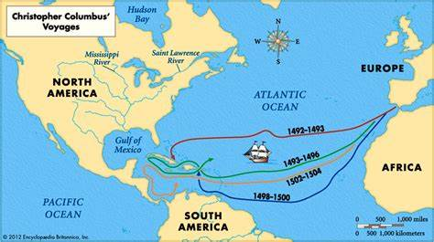
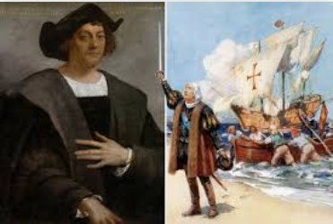
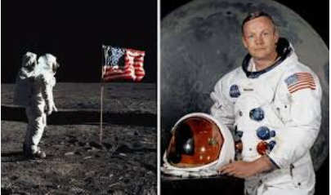
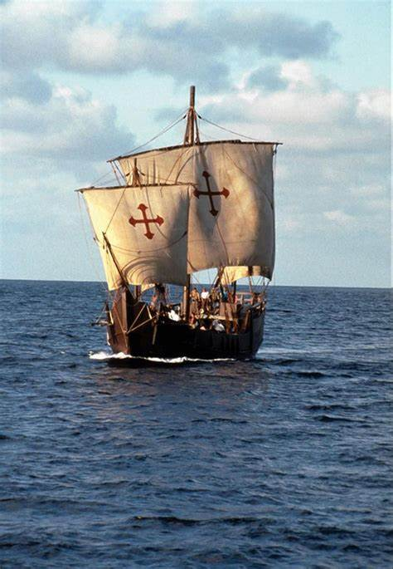
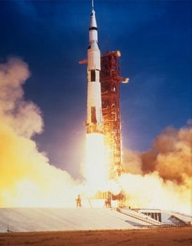
Intrepid Explorers
Timeline
1451 | 1465 | Aug 1492 | Oct 1492 | 1506 | 1930 | 1949 | 1962 | 1969 | 2012
Christopher Columbus was born | Columbus becomes a sailor at 14 | Columbus sets sail on his first voyage with 3 ships | Columbus reaches the Bahamas | Christopher Columbus died | Neil Armstrong was born | Armstrong became a fighter pilot. | Armstrong becomes an astronaut | Armstrong landed on the moon | Neil Armstrong died
Key Facts
Christopher Columbus | Neil Armstrong
Christopher Columbus’ family were poor, so he did not go to school. He became as sailor at 14. To follow his dream as a sailor, Christopher Columbus needed money, so the King of Spain gave him money to buy ships. He set sail in 1492 with three ships. Christopher Columbus sailed and discovered new lands. They called it The New World. Native Americans lived on the islands, but Christopher Columbus called them Indians because he thought he had landed in the ‘Indies’. Columbus drew maps to show what he had discovered. He went back 3 times to explore more of America | Neil Armstrong got his pilot's licence when he was just 16, before he could even drive a car! Neil and his crew flew to the Moon in a spacecraft called Apollo 11. Armstrong was part of the team of astronauts who were the first people to land on the moon. When Neil Armstrong landed on the moon he famously said “That’s one small step for man, one giant leap for mankind.” When Armstrong returned from the moon, he carried on being an astronaut and went on lots of other voyages When he was older, Armstrong taught other people about being an astronaut.
Key Vocabulary
commemorate | To celebrate and remember a person or event.
explorer | An explorer is someone who goes on an exploration.
exploration | A journey where explorers travel to unfamiliar places.
significant | Important and worth knowing about.
compass | An item used to show direction.
voyage | A long journey, especially by ship. The word voyage can also be used to describe journeys in space.
native | Being born in a specific place.
continent | A large area of land that may be made up of several countries.
astronaut | A person trained to command, pilot, or serve as a crew member of a spacecraft.
engineer | A person who designs, builds, or maintains engines, machines, or structures.
St Mary’s C of E
Primary School and Nursery
‘Be the BEST you can be’

