Slide 1
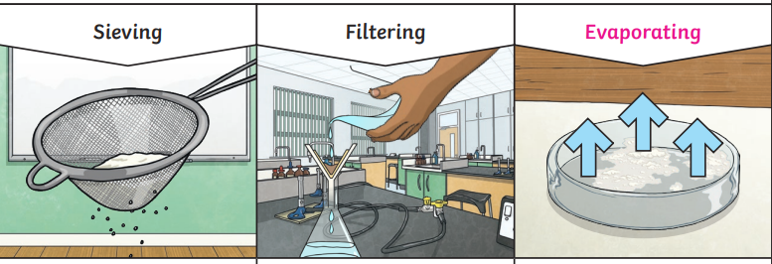
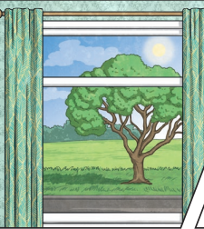
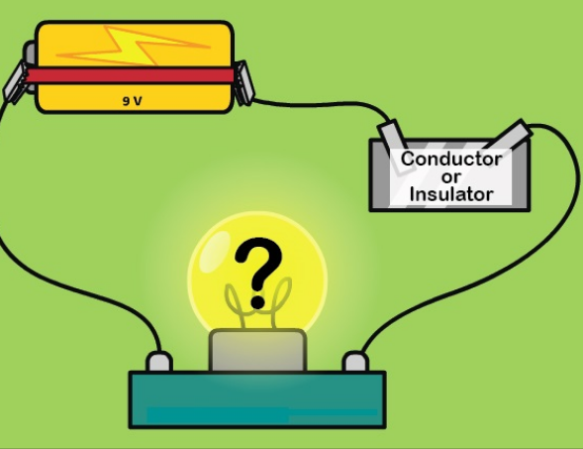
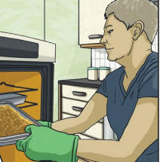
Science: Properties and Changes of Materials
St. Mary’s Church of England Primary School and Nursery
Be the BEST you can be
General Knowledge
Key Vocabulary
Conductor | A material that heat or electricity can easily pass through.
Transparency | A transparent object lets light through.
Insulator | Material that does not let heat or electricity through.
Evaporation | to produce young
Thermal | Heat.
Dissolve | To cause a solute to pass into a solution
Solution | When a substance dissolves in a liquid.
Irreversible | A process that is not reversible.
Reversible | A process that can be reversed.
Soluble | A substance that can be dissolved in a solvent.
Solute | A substance that is dissolved in another substance, called a solvent.
Irreversible changes
often result in a
new product being
made from the old
materials (reactants).
For example, burning
wood produces ash.
Mixing vinegar and
milk produces casein
Plastic.
Smaller materials are able to fall through the holes in the sieve, separating them from larger particles. | The solid particles will get caught in the filter paper but the liquid will be able to get through. | The liquid changes into a gas, leaving the solid particles behind.
Changes of state
Dissolving
A solution is made when solid particles are mixed with liquid particles. Materials that will dissolve are known as soluble. Materials that won’t dissolve are known as insoluble. A suspension is when the particles don’t dissolve.
Conductor
A conductor is a material that heat or electricity can easily travel through. Most metals are both thermal conductors (they conduct heat) and electrical conductors (they conduct electricity).
Insulator
An insulator is a material that does not let heat or electricity travel through them. Wood and plastic are both thermal and electrical insulators.
Transparency
A transparent object lets light through so the object can be looked through, for example glass or some plastics.

