Slide 1
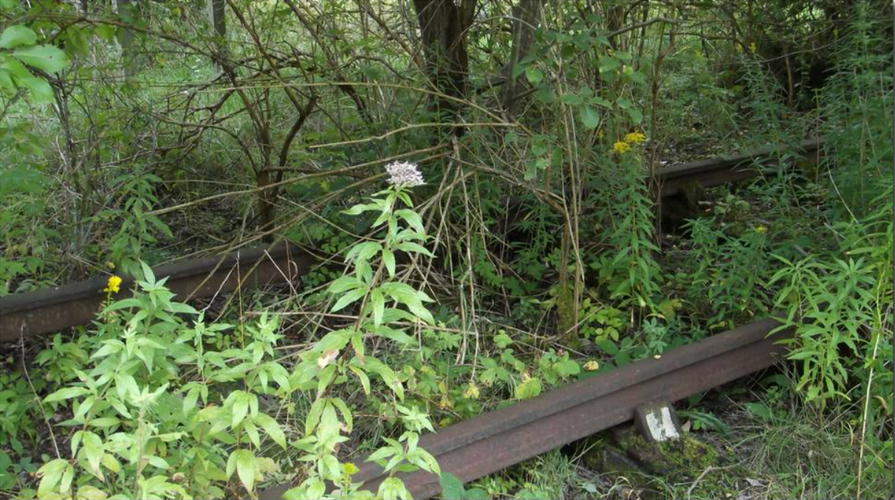
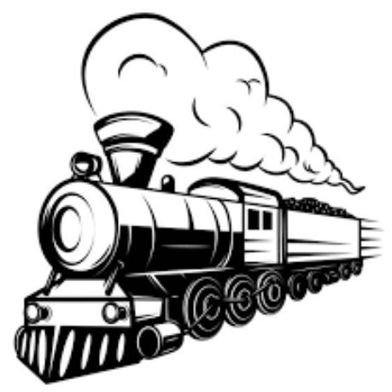
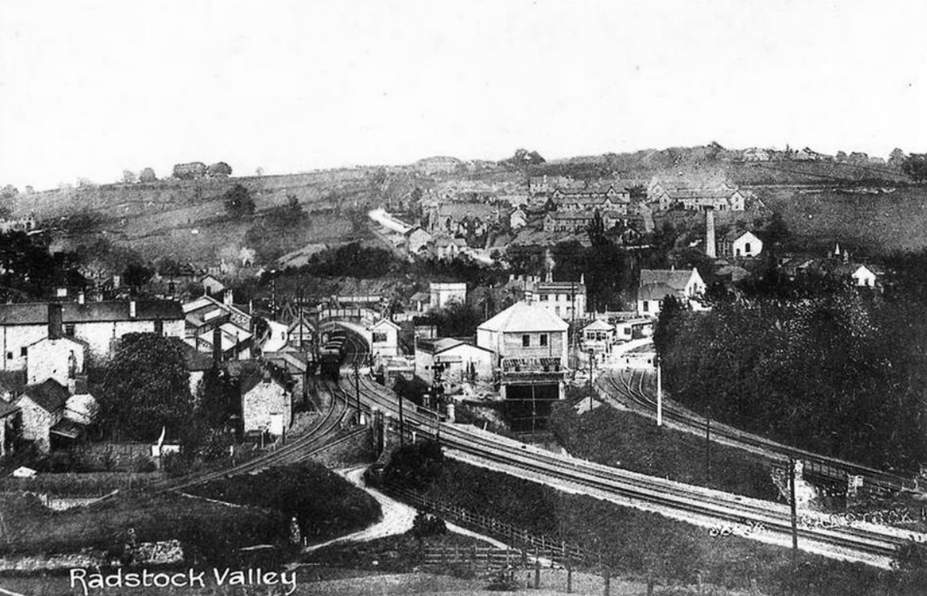
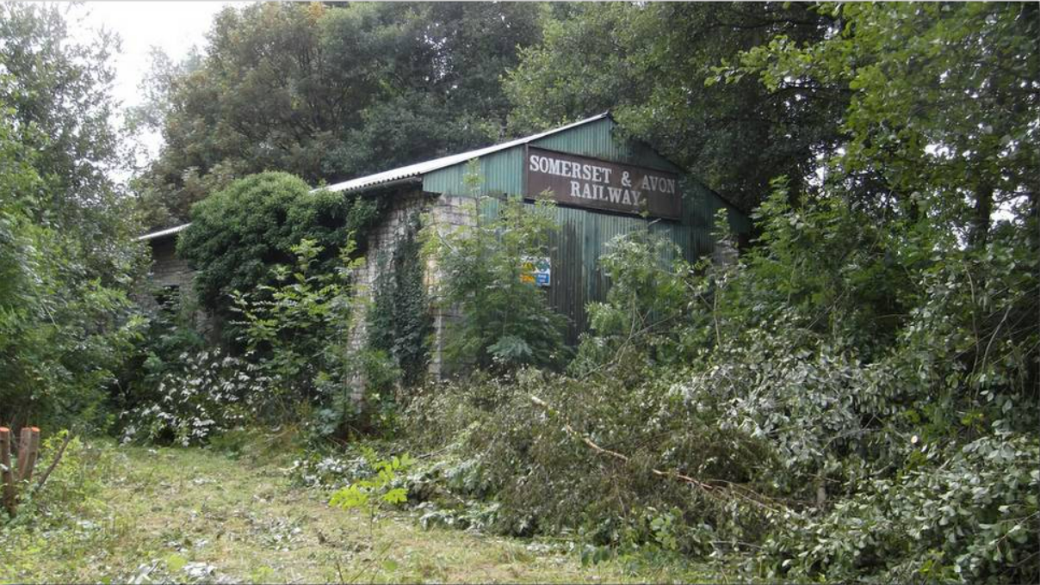
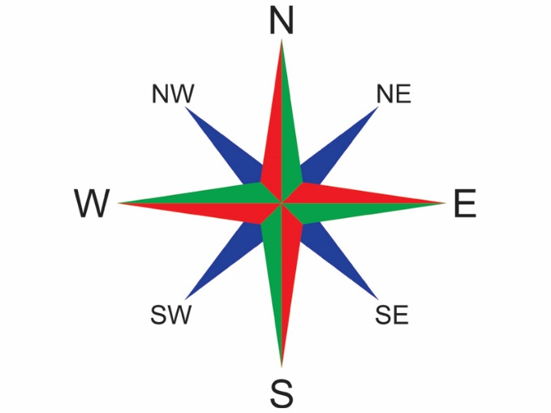


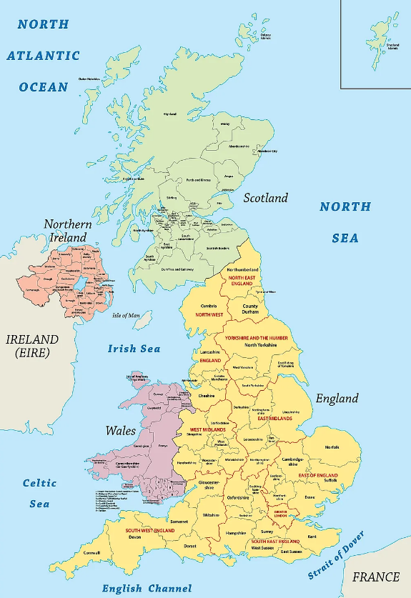
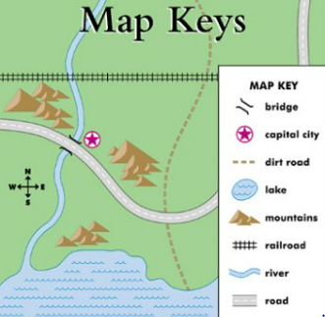
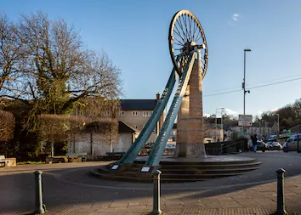
St Mary’s C of E
Primary School and Nursery
‘Be the BEST you can be’
Out & About
Our Local Area
Evidence of the railways can still be found in Radstock.
A compass is a tool used to show directions. It has a needle that spins and always points to north. You can turn the compass so that the needle points to north on the dial. If you know that you should be heading south, then you can go in the right direction.
Radstock was a mining town once served by two railways.
Key Vocabulary
city | A large town.
town | A town is a place with many streets and buildings, where people live and work. Towns are larger than villages and smaller than cities.
village | A village consists of a group of houses, together with other buildings such as a church and a school, in a country area.
compass | A compass is an instrument that you use for finding directions. It has a dial and a magnetic needle that always points to the north.
key | The key on a map is a list of the symbols used and their meanings.
symbols | A symbol of something is a shape that is used to represent it.
location | A location is the place where something happens or is situated.
Radstock | Radstock is a town in Somerset, England.
Writhlington | Writhlington is a suburb of Radstock
United Kingdom | The United Kingdom, made up of England, Scotland, Wales and Northern Ireland, is an island nation in north-western Europe.
There are different styles of houses in our local area.
A map key is a little box of information found at the bottom of a map. It contains an explanation of what the different lines and symbols on the map mean, as well as a scale for you to work out distance.
Radstock is in the South West of England, near the city of Bath.

