Slide 1
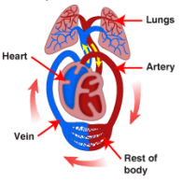
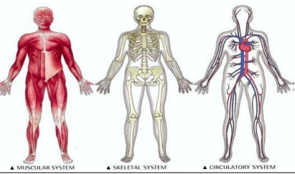
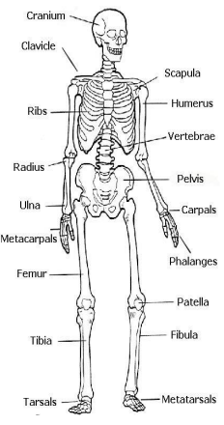
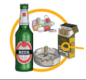
Term 1
Science-Year 6
St. Mary’s Church of England Primary School and Nursery
Be the BEST you can be
 | Key Vocabulary
Circulatory System | The parts of an animal’s body comprising the heart, veins, capillaries and arteries
The Heart | A muscular organ that pumps blood through the body
Veins | Blood vessels that carry blood towards the heart.
Artery | Blood vessels that deliver oxygen-rich blood from the heart to the tissues of the body.
Blood Vessels | Part of the circulatory system that carries blood (a vein, artery or capillary).
Alveoli | Tiny air sacs in the lungs where gas exchange take place.
Blood | A body fluid which transports the necessary substances such as nutrients and oxygen.
Capillaries | Capillaries are the smallest blood vessels in the body.
Nutrients | Substances that animals need to stay alive and healthy.
Villi | Structures in the small intestines which help absorb nutrients.
CIRCULATORY SYSTEM – is a group of organs and vessels which transport blood around the body. The heart pumps blood to the lungs to get
oxygen. The oxygenated blood is then pumped around the body. Arteries carry oxygenated blood away from the heart. Veins carry de-oxygenated blood towards the heart.
DIGESTIVE SYSTEM - Humans and animals need food to gain nutrients and energy. Different organs are involved in the process
A balanced diet is important to stay healthy.
The five main food groups are:
• Carbohydrates (give you energy)
• Protein (required for growth and repair of our bodies)
• Dairy and alternatives (help strengthen our bones and
teeth)
• Fruit and Vegetables (help us build healthy cells and
give us vitamins and minerals
• Fats and Sugars (provide energy and help with building
our bodies)
LIFESTYLE - exercise is important to help keep our bodies healthy. Regular exercise:
• Strengthens muscles, including the heart.
• Improves circulation
• Increases the amount of oxygen around the body
• Releases brain chemicals which help you feel calm and relaxed.
• Helps you sleep more easily
• Strengthens bones.
Drugs, alcohol and smoking have a negative effect on the body.
HUMAN SKELETON – the
human skeleton provides
support, protection and
movement.

