Slide 1

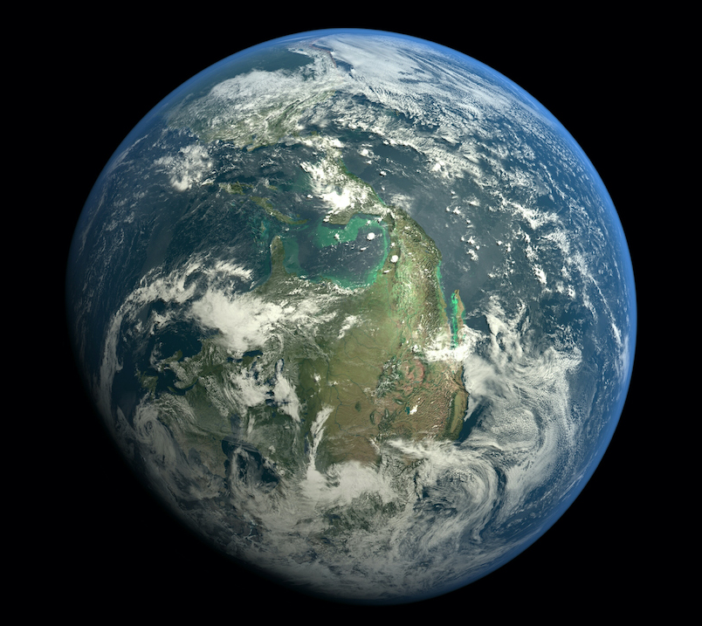
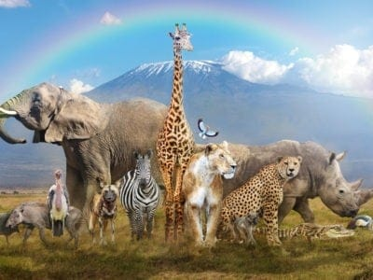
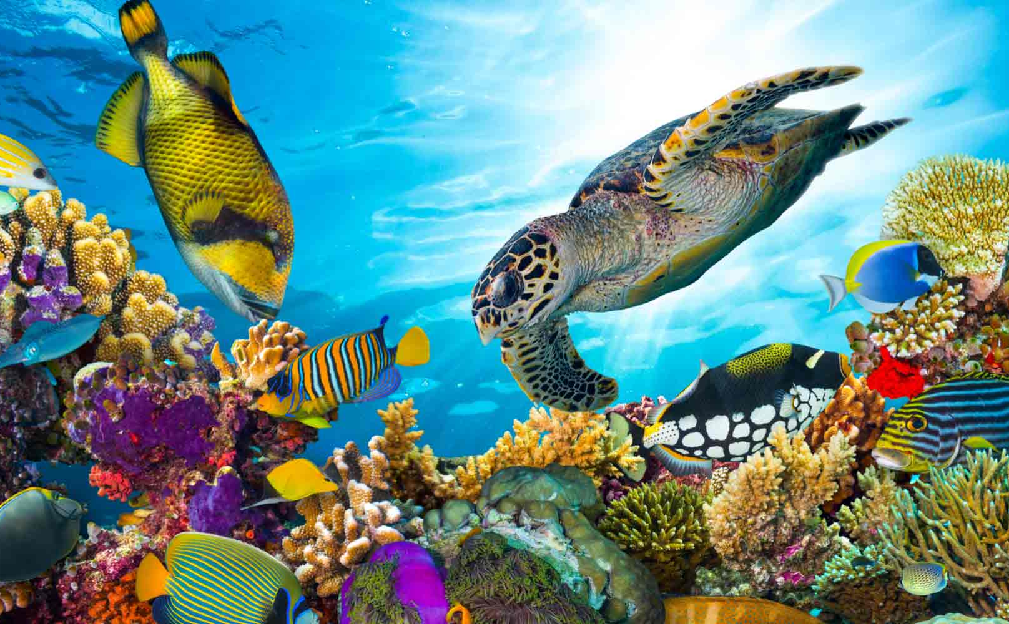
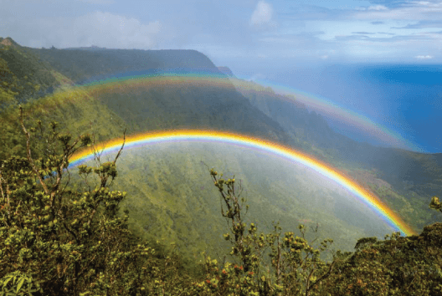
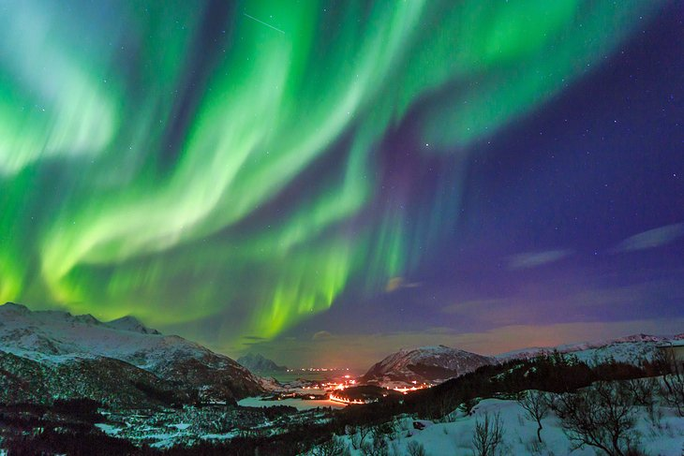
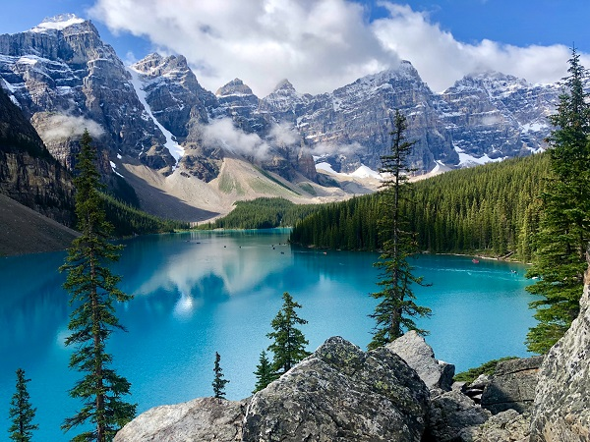
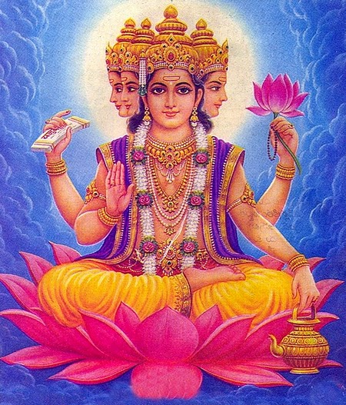
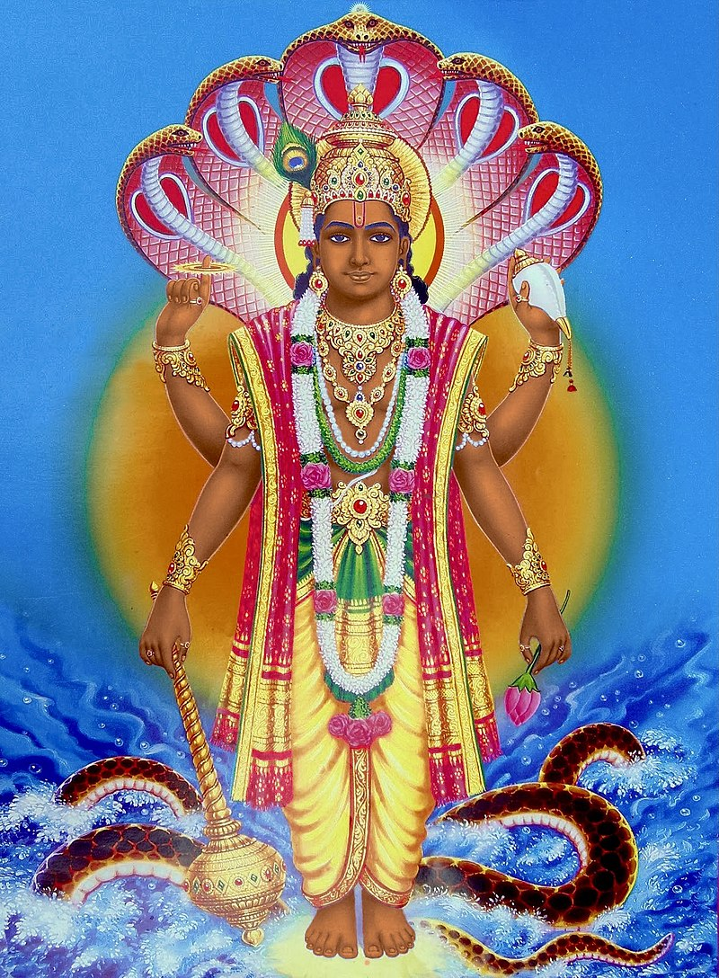
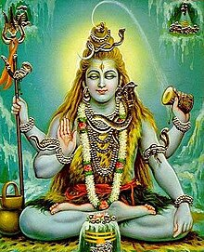
St Mary’s C of E
Primary School and Nursery
‘Be the BEST you can be’
Why is our world special?
Key Vocabulary​
Emotions | An Emotion is a feeling, such as happiness, love, anger, fear or hatred
Humanist | Someone who believes that people can achieve happiness and live well without a religion
Judaeo-Christian | Having historical connections to both Christianity and Judaism
Creation | In many religions, creation is the making of the universe, Earth and creatures by God
Evolution | A process of gradual change. It takes place over many generations.
Goddess | In many religions a goddess is a female spirit or being that is believed to have power over a particular part of the world or nature.
Brahma/Brahman | A Hindu god: Brahma is said to be the creator of the whole universe.
Vishnu | In Hinduism Vishnu is the preserver god, which means he protects the earth from being destroyed and keeps it going
Shiva | In Hinduism Shiva is known as the destroyer of because he removes all evil from the world
Krishna | An important Hindu god, an incarnation of Vishnu, Second god of the Hindu trinity.
The stories of creation
Christians | Humanists | Hindus
God created the world and everything in it. | The big bang created the universe and everything in it just evolved. | There are many gods involved in the process of creating the world. Each one has a special job.
This is our world and its full of amazing things in nature created by God
The Hindu Gods of Creation
Brahma:
The creator
Vishnu:
The protector
Shiva:
The destroyer

