Slide 1
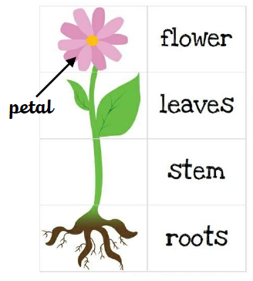
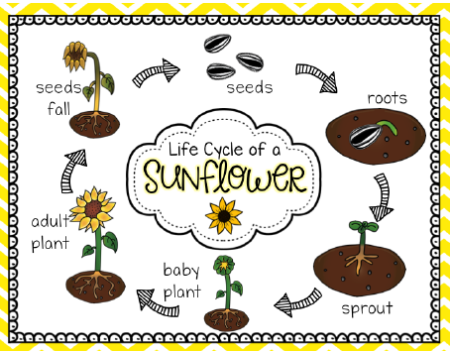
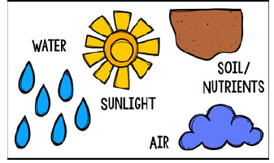
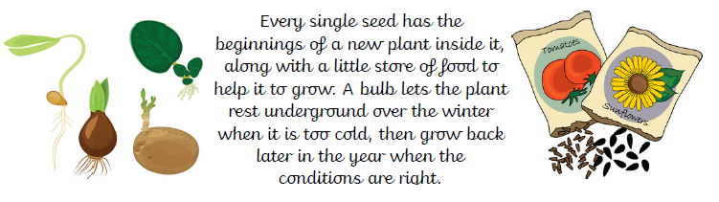
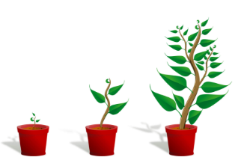
St Mary’s C of E
Primary School and Nursery
‘Be the BEST you can be’
Plants
Parts of a Plant
What plants need to survive
Life Cycle of a Plant
Key Vocabulary
roots | The part of a plant that usually grows underground. Roots take up water and nutrients, and hold the plant in the soil.
stem | The main stalk of a plant that develops buds and shoots and usually grows above ground.
seed | The small part of a flowering plant that grows into a new plant.
bulb | A plant bud that begins to grow underground.
leaf | One of the usually green, flat parts of a plant or tree that grows from the stem or branch.
flower | The part of a plant that has petals and that makes fruit or seeds
tree | A woody plant that has a long main trunk and many branches.
plant | One of a large group of living things that use sunlight to make their own food.
germinate | To start or cause to start growth
life cycle | The sequence of changes that a living thing goes through as it grows and develops.
Difference between a seed and bulb

