Slide 1

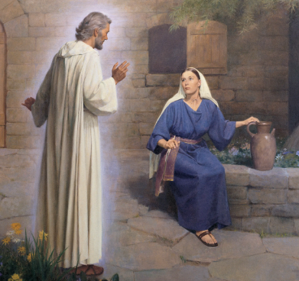
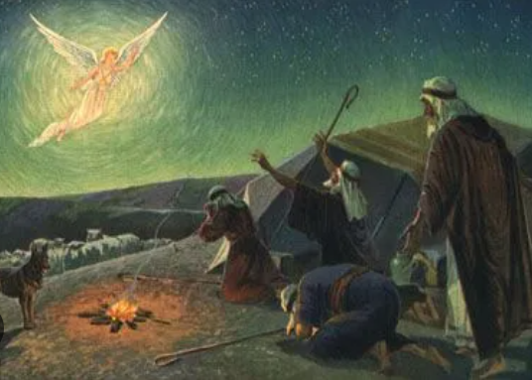
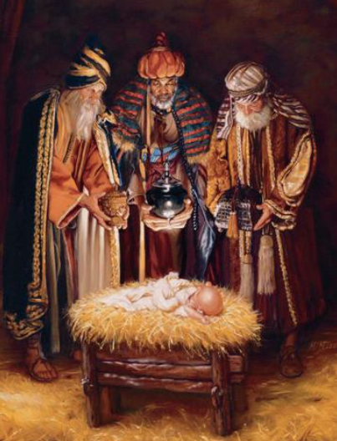
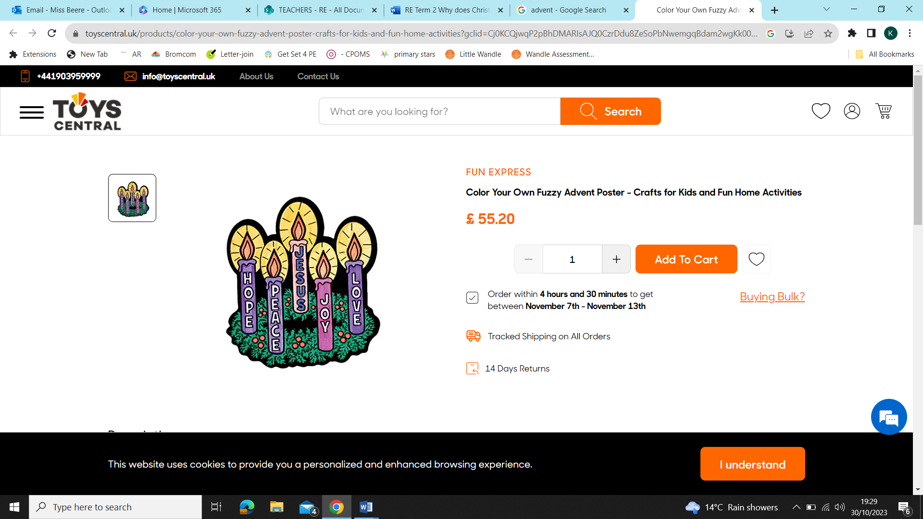
St Mary’s C of E
Primary School and Nursery
‘Be the BEST you can be’
Why is Christmas special to Christians?
Key Vocabulary​
Incarnation | God became a physical human being.
Parables | Stories of Jesus.
Jesus | Saves from all who do wrong
Nativity | A parable that tells of the birth of Jesus
Advent | The 4 weeks leading up to Jesus’ birth where Christians focus their prayers on hope, peace, love and joy.
Wreath | A leafy green circle that symbolises continuous life
General Knowledge:
An angel visited Mary and told her she was going to have a baby and call him Jesus.
Mary and Joseph travelled to Bethlehem, there was no room in an Inn so they found a stable to have their baby.
The Shepherds followed an Angel to Bethlehem to meet the Baby Jesus.
The wise men followed a bight star bringing gifts of Gold, Frankincense and Myrrh.
Angel Gabriel
Mary
The Shepherds following the angel to Baby Jesus
Gifts from the Three Wise Men
Gold | As a symbol of Kingship on Earth.
Frankincense | An incense as a symbol of deity
Myrrh | An oil as a symbol of death.
Advent wreath:
One candle is lit each week to mark down the 4 weeks leading up to Christmas. The last candle is lit on Christmas day to symbolise the Birth of Jesus.

