Slide 1

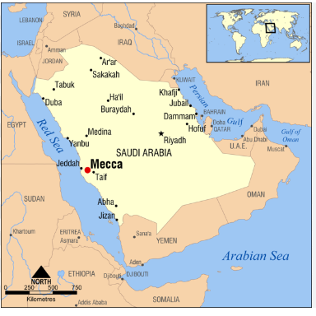
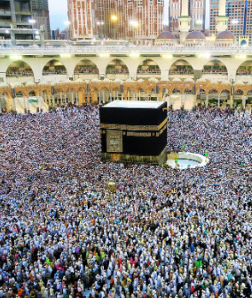
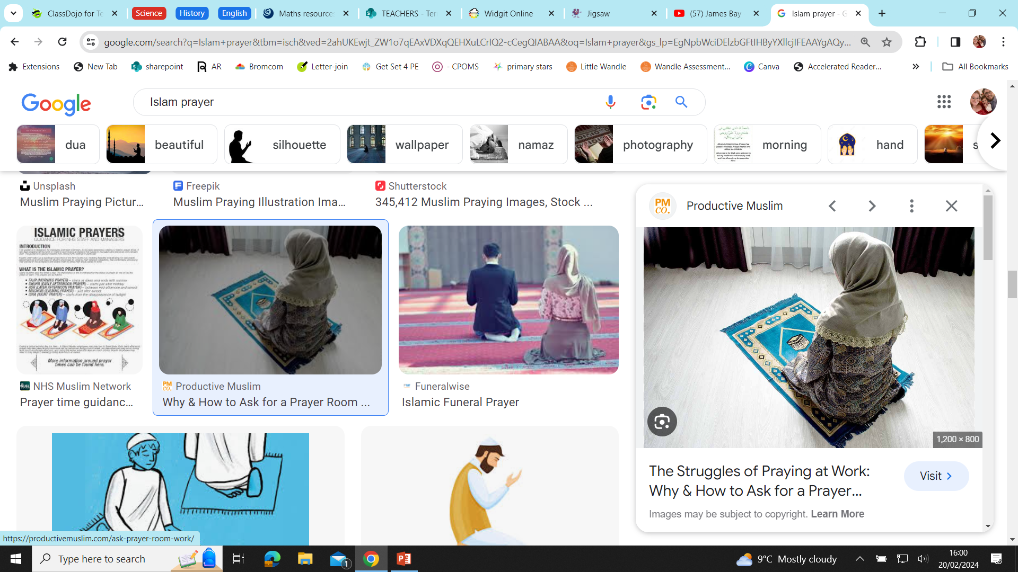
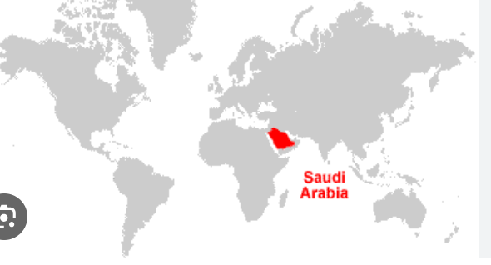
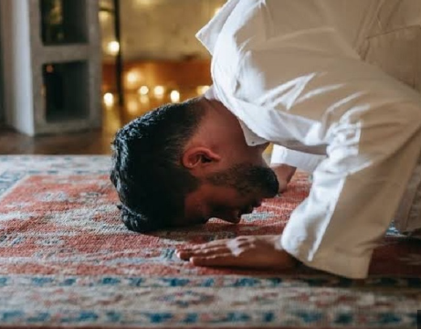
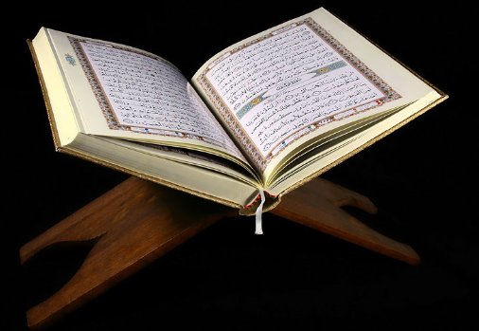
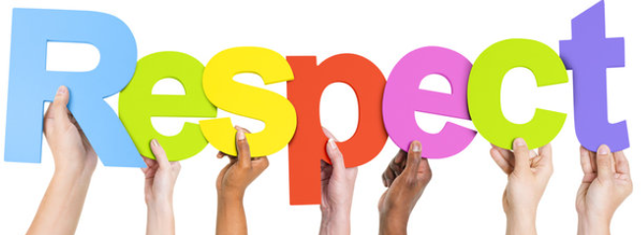
St Mary’s C of E
Primary School and Nursery
‘Be the BEST you can be’
Who is God to Muslims?
General Knowledge:
Muslims believe that Allah is perfect. He is the one who made human beings, the one who watches them during life and the one who decides what happens when life is over.
​Key Vocabulary
Allah | Muslim name for God
Muhammad | Messenger chose by Allah
Makkah | City where Islam began
Saudi Arabia | Country Makkah is In
Qur’an | The holy book for Muslims
Muslims Pray 5 times a day using a prayer mat. They always make sure they are facing the direction of Makkah.

