Slide 1
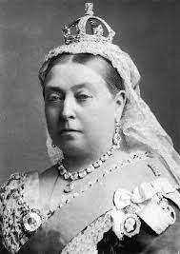
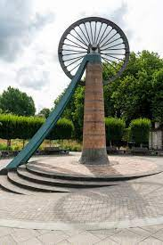
St. Mary’s Church of England Primary School and Nursery​
Be the BEST you can be​
Year 1 | History | History: Mighty Miners – What’s Under My Feet?
Timeline
 | Coal mining flourished
1760 Start of the Industrial Revolution | 1763 Coal mining was discovered in Radstock | 1819 Queen Victoria was born | 1837 Queen Vicotia began her reign | 1800-1850 Several coal mines opened in this area | 1874 Radstock Railway station first opened | 1897 Victorian Market Hall opened - now Radstock Museum | 1901 St Mary’s school opened Queen Victoria died | 1973 Last coal mines closed – 1 in Writhlington
Key Vocabulary
Radstock | a town in Somerset – our most local town/community
Monarchy | A King or Queen who reigns over a country
mine | a deep hole made in the earth to get to useful minerals
mining | The act of digging up coal or other minerals
miner | a person whose job is to dig coal or other minerals from a mine
child labour | full-time employment of a child under a minimum age
coal | a hard black mineral that is found in the earth and used for fuel
colliery | a coal mine including all the buildings and equipment
Queen Victoria | the Queen of Great Britain from 1837 - 1901
Victorian | Relating to the time of the reign of Queen Victoria
Queen Victoria was the Queen of the United Kingdom between
1837 to 1901. Her reign was one of the longest in British history and the era was named after her. Whilst she was Queen, Britain went through a huge change. Factories and machines were built to serve a growing population significantly changing how people lived and worked.
Coal was discovered in Radstock in 1763 and continued until 1973. The town grew a lot after this and many mines were opened. Working in the mines was very dangerous and even children had jobs in the mines.
Life for Radstock’s children – their homes, lifestyle and schooling was very different;

