Slide 1

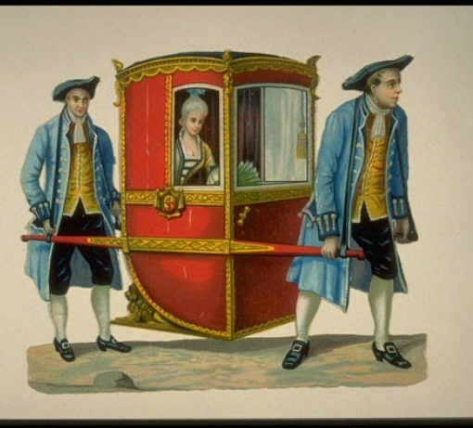
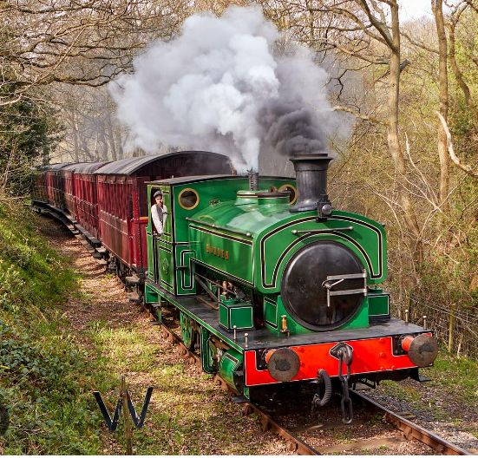
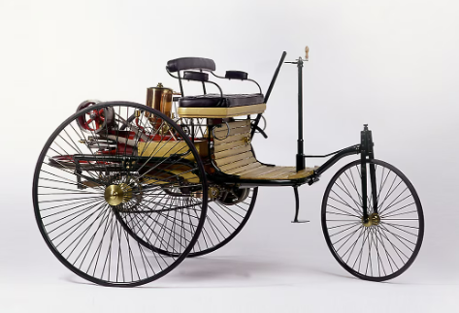
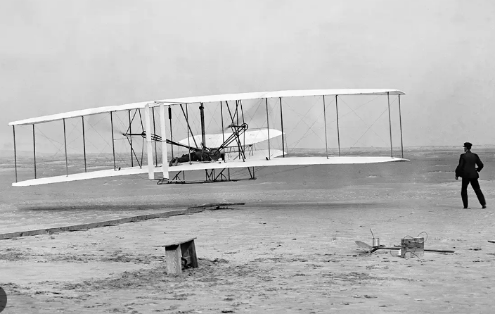
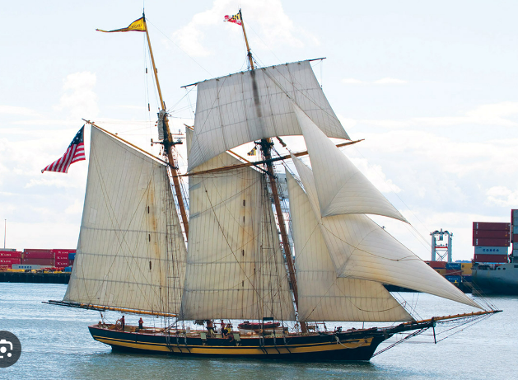
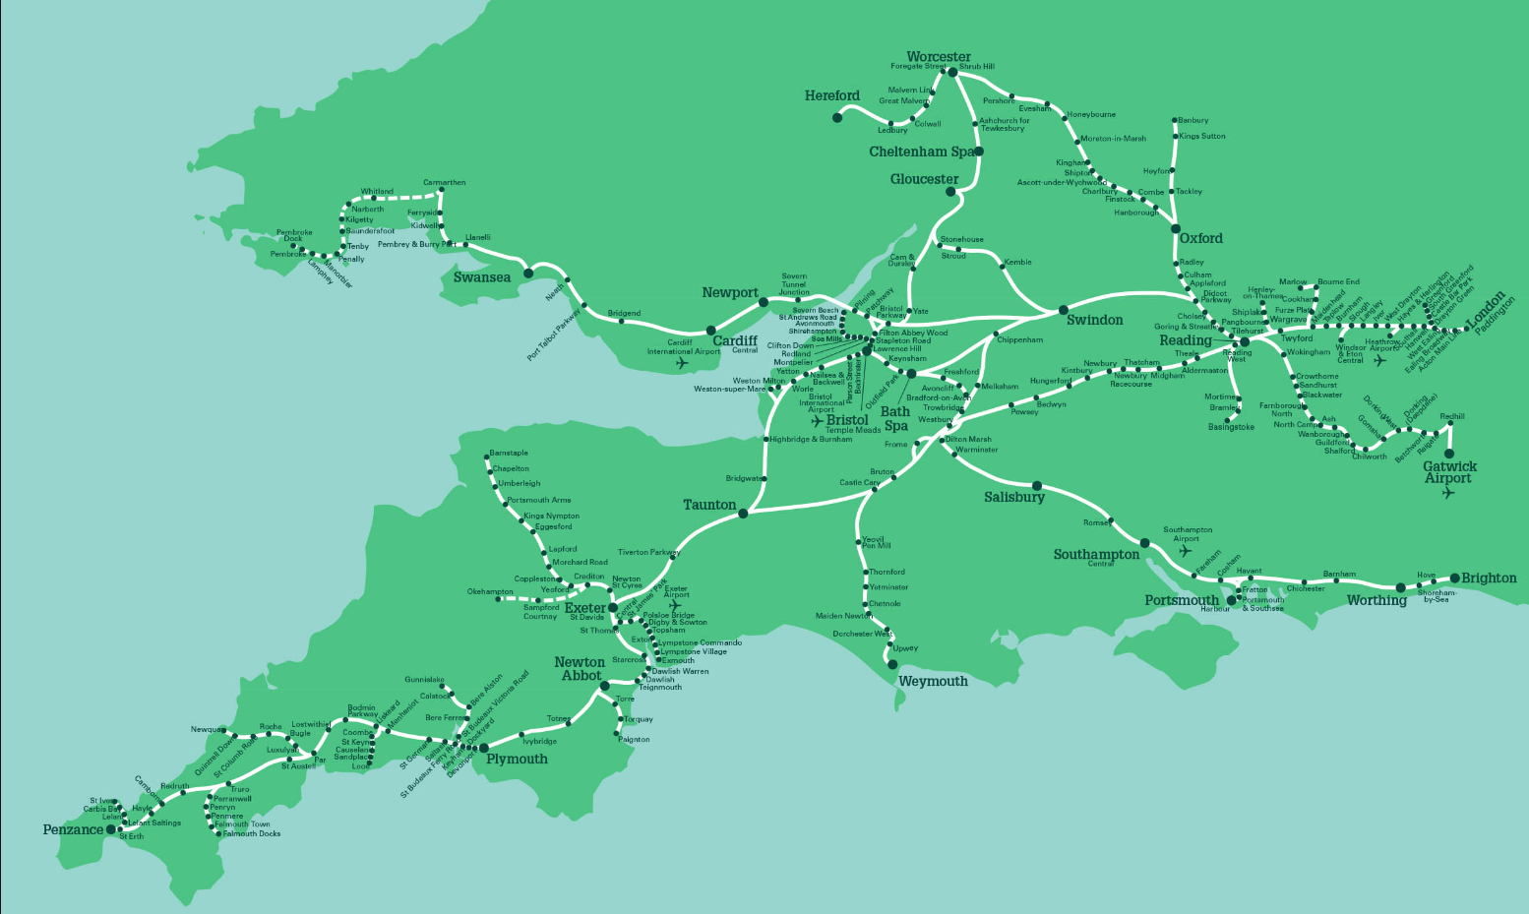
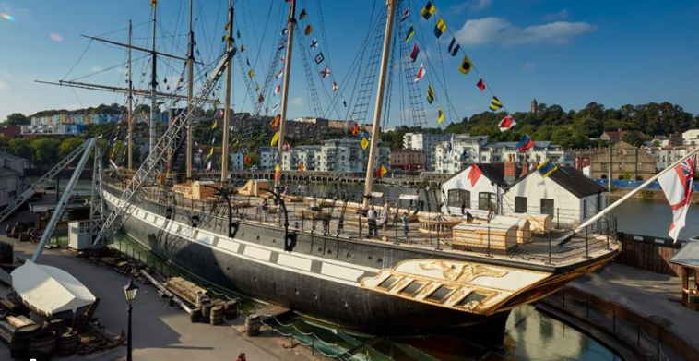
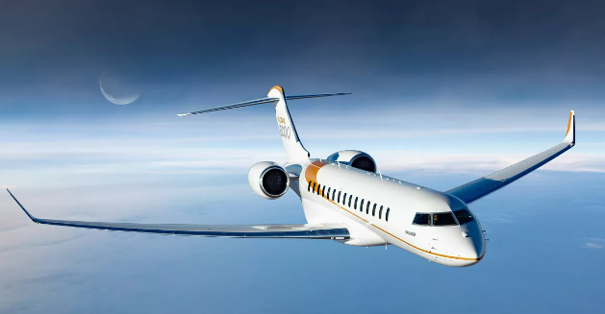
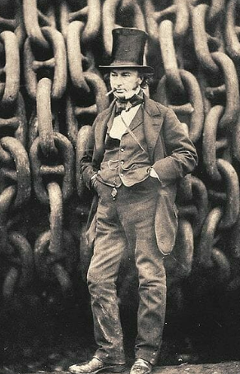
Transport
St. Mary’s Church of England Primary School and Nursery
Be the BEST you can be
Timeline
2000 BC Sedan chair | 1450 Sailing ship | 1814 Steam Train | 1833 Great Western railway | 1843 SS Great Britain Launched | 1883 First engine powered car | 1903 First motor driving aeroplane | 1957 Jet Aeroplanes
 | Key Vocabulary
Transport | A way to move from one place to another
Great Western | The railway system in the south west of England
Engineer | Someone who builds something that has moving parts
Design | A plan to create something
Construction | The process of building a design
Railway | The tracks that trains can travel on
Steam power | The use of burning coals to create power to make something move.
Industrial revolution | A time of great change to factory's and transport in the United Kingdom.
General Knowledge:
Travel has changed drastically throughout history. From how people travelled to how fast and how far people could travel. In our local area the greatest advancements in travel are all thanks to Brunel! He developed the Great Western Railway. This is the railway system we use to this day in our area.
Did you know?
Brunel was the chief engineer on the great western railway system.
Temple meads train station in Bristol and Paddington Train station in London were both designed by Brunel.
Isambard Kingdom Brunel

