Slide 1

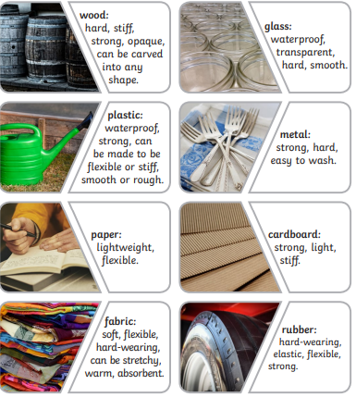
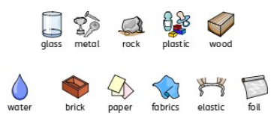
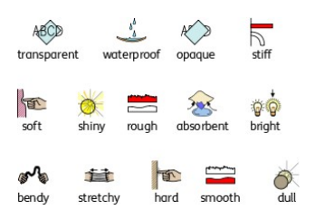
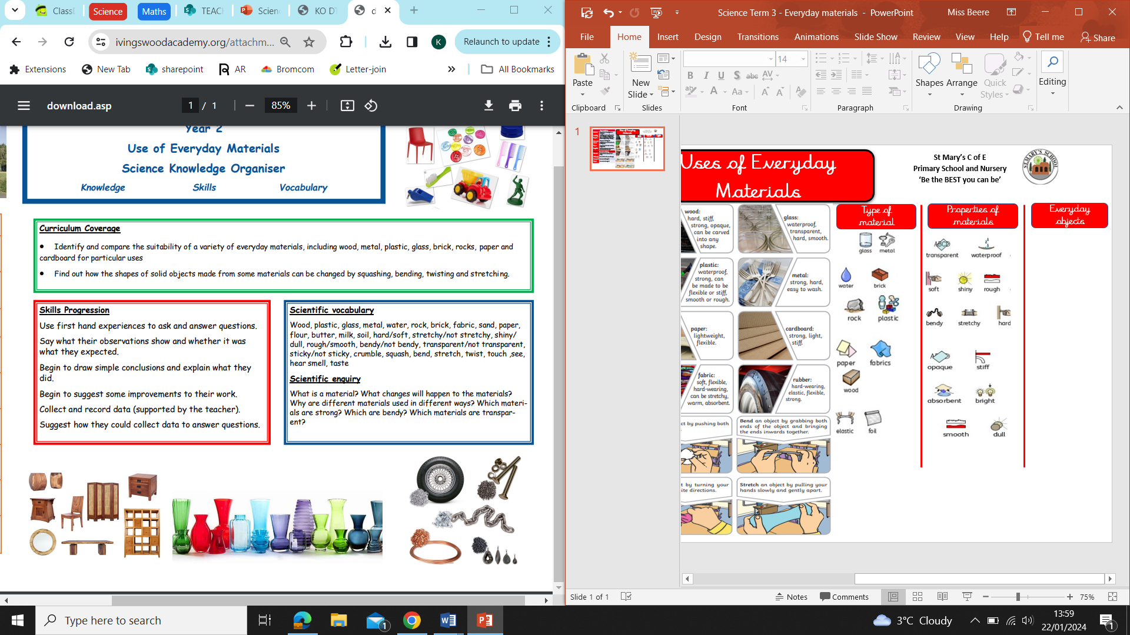
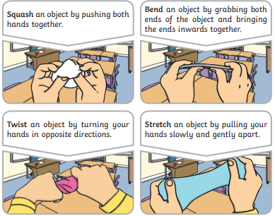
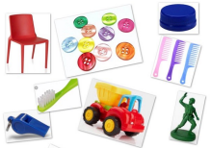
Uses of Everyday Materials
St Mary’s C of E
Primary School and Nursery
‘Be the BEST you can be’
Key vocabulary
Materials | Materials are what objects are made from
Suitability | Suitability means having the properties which are right for a specific purpose
Properties | This is what a material is like and how it behaves (soft, stretchy, waterproof)
Man-made | Things are created by people
Natural | Things that exist in nature and are not made by people
Purpose | The features that make something recognisable
Recyclable | Waste or materials which can be processed and used again
Revised vocabulary
Absorbent | Materials that soaks up liquid easily
Waterproof | Does not let wat3er pass through
Transparent | You can see through it.
Opaque | You cant see through it.
Type of material
Properties of materials
Everyday objects

