Slide 1
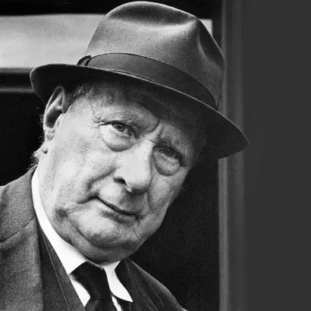
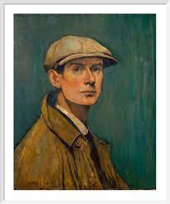
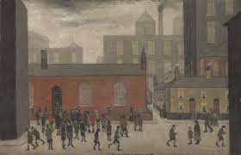
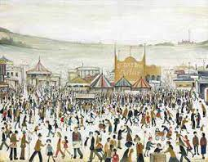
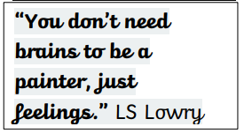
St. Mary’s Church of England Primary School and Nursery​
Be the BEST you can be​
Year 1 | Art | LS Lowry
KEY VOCABULARY
artist | a person who does something with a great deal of skill or talent
Lowry | Lowry is famous for painting scenes of life in the industrial districts of North West England in the mid-20th century.
compare | to note or describe the similarities or differences of
similarities | a specific point or instance of likeness
differences | a particular instance of differing
seascape | a view of the ocean or a representation of it, such as a painting
industrial | having to do with the making of goods and services by industry
background | the part of a picture or scene that is towards the back or seems to be furthest away
perspective | a way of showing objects on the flat surface of a picture so that they seem the correct size and distance from one another
matchstick figures | Characterised by Lowry – people represented simple shapes, thin black legs with curved feet, simple block colours. Simplicity of them allowed Lowry to make his paintings look busy
self portrait
Laurence Stephen Lowry was a famous English painter. He was born on 1st November 1887, during the Victorian age. Lowry was born in a town in Manchester called Stretford.
Lowry’s art work was different to that of the other artists of that time. His paintings showed life in an industrial town and the figures in his paintings were known as matchstick men because of the way he painted them.

