Slide 1
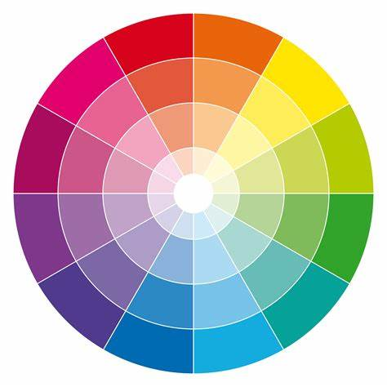
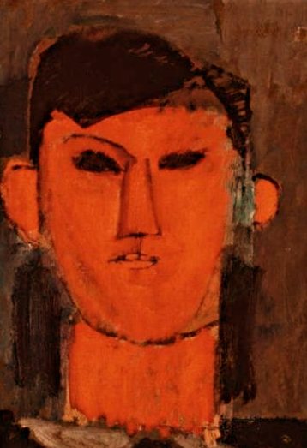
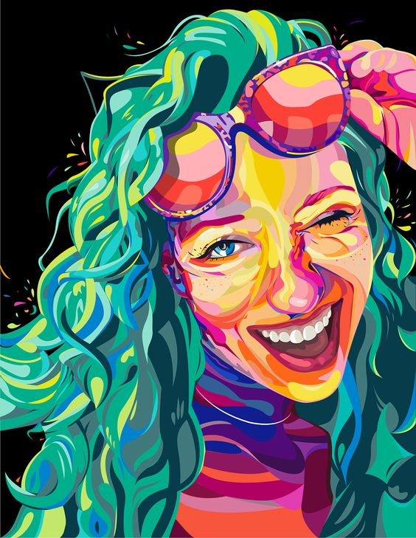
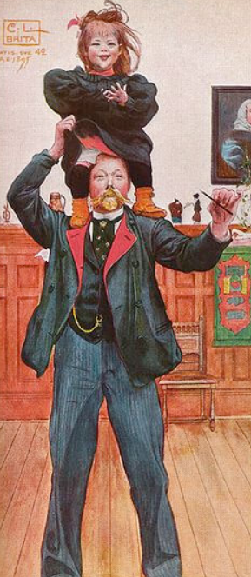
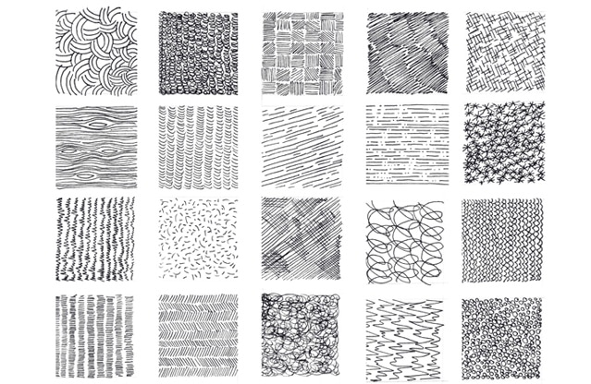
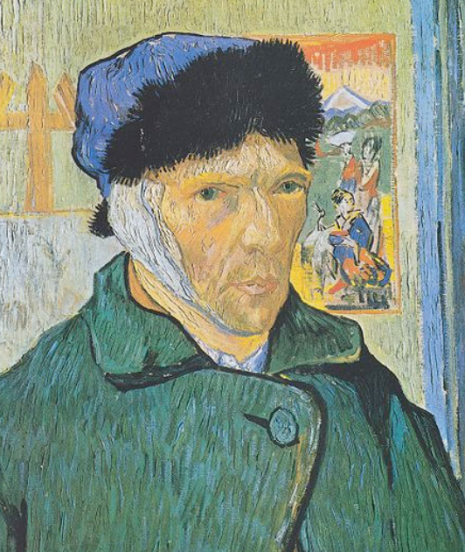
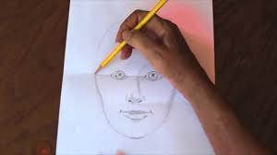
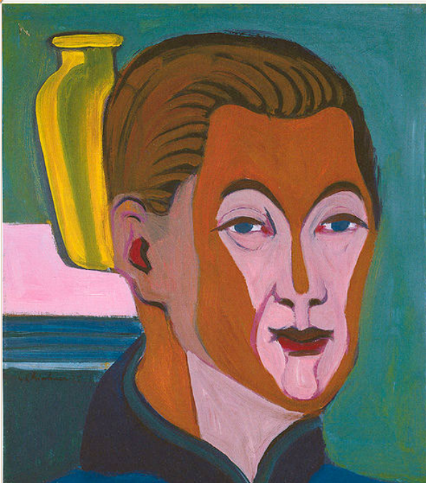
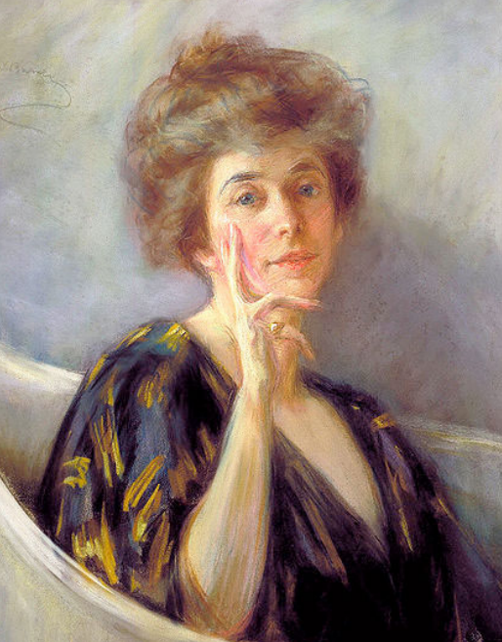
Emotions
Self Portraits
St Mary’s C of E
Primary School and Nursery
‘Be the BEST you can be’
Key Concepts
A portrait is a painting or a photograph of a persons face and its expression. The purpose of a portrait is to show the likeness, personality or even the mood of a person. A self-portrait is a picture of the artist drawing it. In the past, people didn’t have cameras to take pictures of people or events they wanted to remember. So, artists would paint portraits of people or of themselves so that future generations would know what they looked like. The earliest example of a self-portrait made was Jan Van Eyck in 1433. Rich people loved having their portraits taken to show off how rich and important they were.
Key Vocabulary
portrait | A portrait is a painting, drawing, or photograph of a particular person.
self portrait | A self-portrait is a drawing, painting, or written description that you do of yourself.
personality | Your personality is your whole character and nature - what type of person you are.
sketching | A sketch is a drawing that is done quickly without a lot of details. Artists often use sketches as a preparation for a more detailed painting or drawing.
medium | A medium is a substance or material in order to produce a particular effect.
observation | Observation is the action or process of carefully watching someone or something.
emotions | An emotion is a feeling such as happiness, love, fear, anger, or hatred, which can be caused by the situation that you are in or the people you are with.
sculpture | A sculpture is a work of art that is produced by carving or shaping stone, wood, clay, or other materials.
form | The form of something is its shape.
tone | A tone is one of the lighter, darker, or brighter shades of the same colour.
line | A line is a long thin mark which is drawn or painted on a surface.
texture | The texture of something is the way that it feels when you touch it, for example how smooth or rough it is.
Artists often use colours in their artwork to show moods and emotions. Colours can be angry, sad, happy, soft, loud and many other things.
Mark Making
Carl Larsson
Did you know?
One of the most famous self-portrait painters was Vincent Van Gogh. He painted a picture of himself 37 times from 1886 to 1889.
Alice Pike Barney
There are lots of different ways you can use a sketching pencil to make marks on a piece of paper.
Ernst Ludwig Kirchner.

